Slide 1


Cancer
Zackery Rogers, Luis Rojas, Hector Ladero, Akanksha Kukhraniya, Mariam Ahmad

Slide 2
Analysis
We’re a team who came together to come up with a statistical analysis on Cancer and the data we have collected pinpoints age, race, sex, location, death rates, diagnosis, and survival rate
We used Python/Pandas, each group member then were task to create Flask API, HTML/CSS, and Javascript.

Slide 3
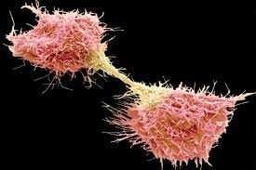
Cancer is a disease in which some of the body’s cells grow uncontrollably and spread to other parts of the body
Cancer can start almost anywhere in the human body, which is made up of trillions of cells.
Normally, human cells grow and multiply (through a process called cell division) to form new cells as the body needs them. When cells grow old or become damaged, they die, and new cells take their place.

Slide 4
Cancer Statistics
1.3 million new diagnoses cases every year
1 in 4 deaths from cancer
Early detection/Improvements in technology have improved prognosis

Slide 5
ZACK
Data Sources
and
ETL

Slide 6

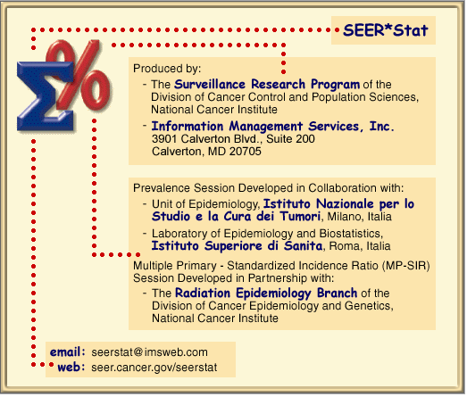



CDC SEER Data

Slide 7



ETL

Slide 8

Heroku

Slide 9
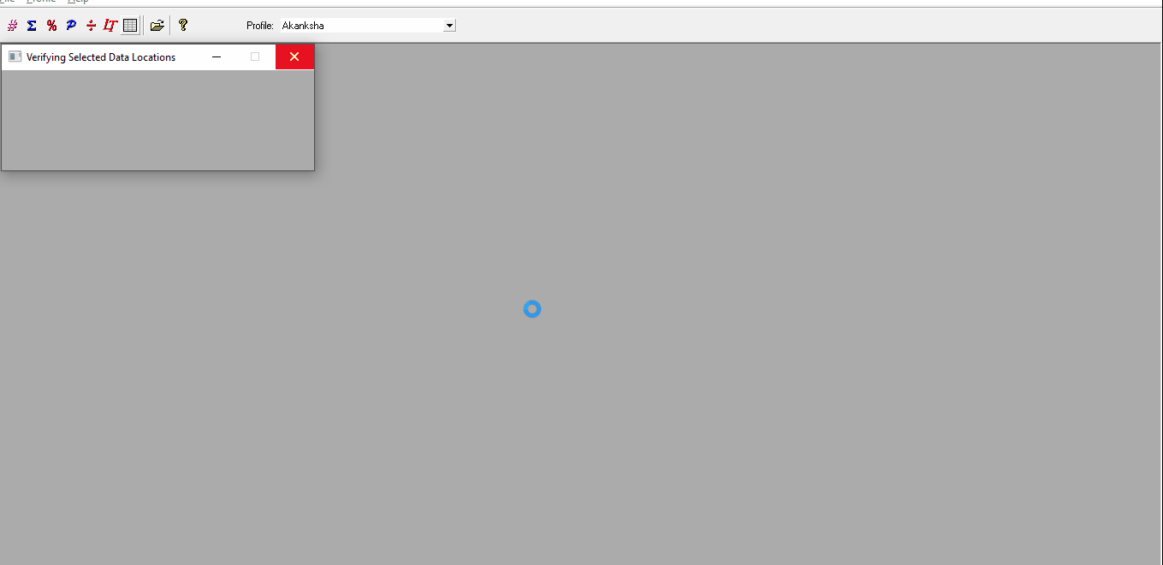
Akanksha Kukhraniya
Data
Visualization

Slide 10
Our first visualization talking about which state has highest number of cancer cases.

Slide 11
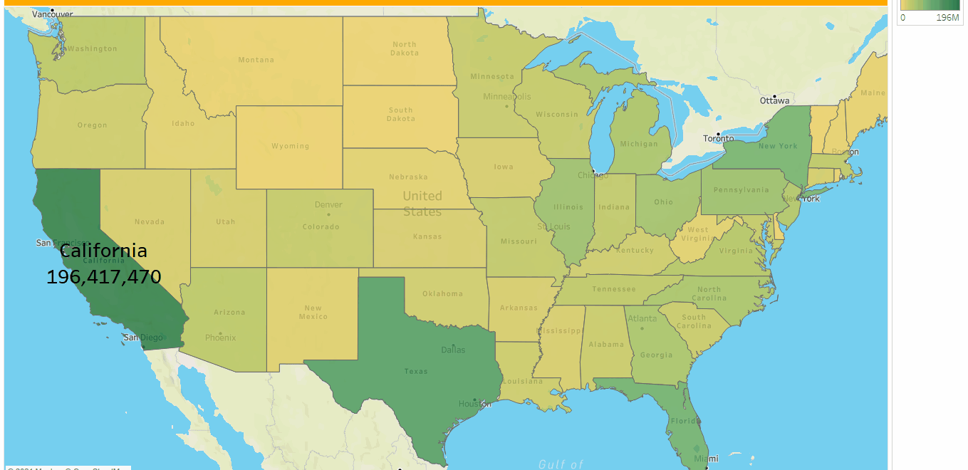

Slide 12
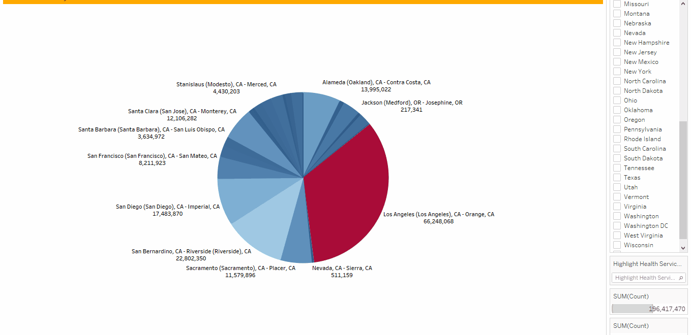

Slide 13
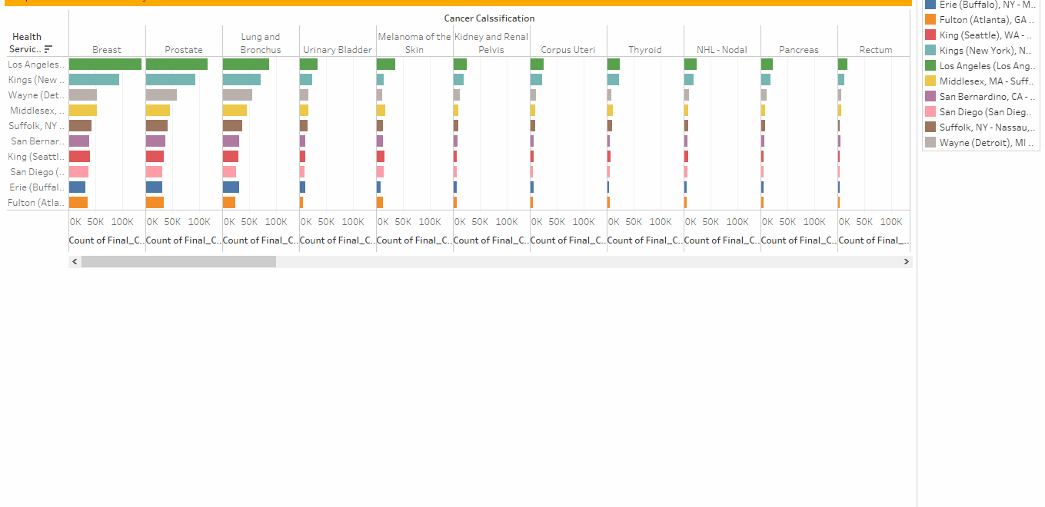
This slide is talking about Top10 State-county cancer data based on CANCER TYPE

Slide 14
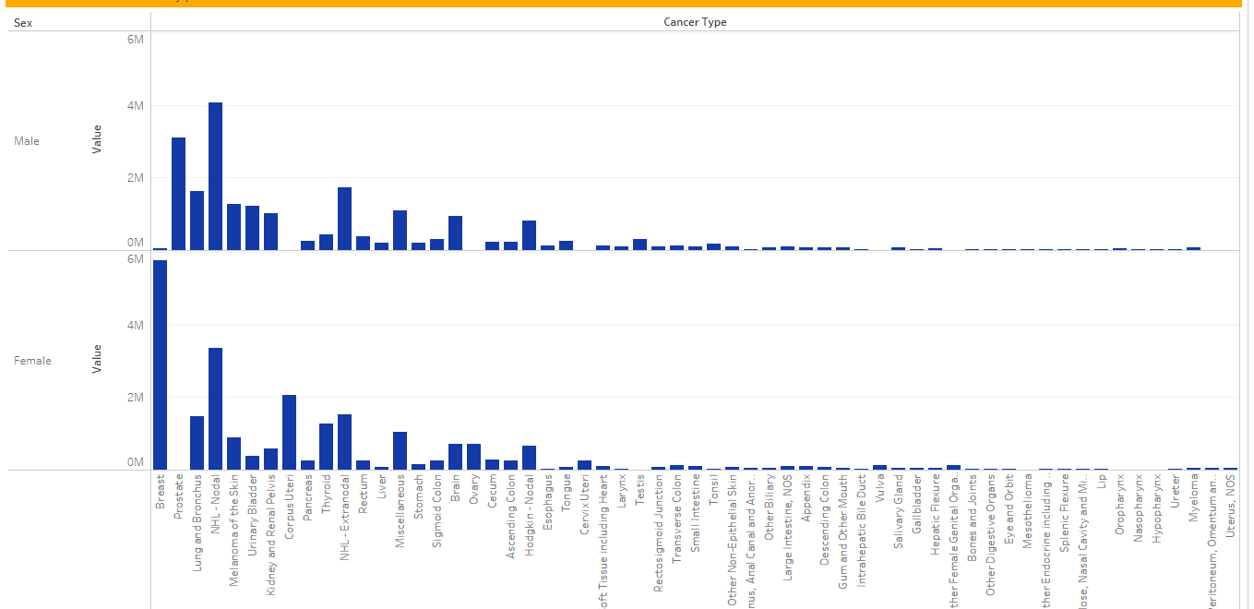
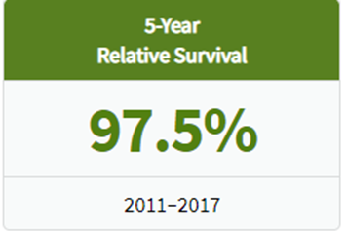
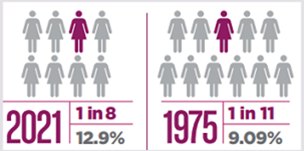
Seer Stage | 5-year Relative Survival Rate
Localized | 99%
Regional | 86%
Distant | 28%
This slide is talking about gender-based cancer analysis. Most cancer are common in both gender. Few are gender specific.

Slide 15

Machine Learning-’Luis HTML/Web ‘Hector’-Website building

Slide 16
Tabloid / Flask / Html
Tabloid
Embed Tabloid Visualizations into the html to interact and display the data with different options and ways to visualize it.
Flask
Use Flask to set up a connection and receive data from the Wisconsin Breast Cancer Database.
Created two different routes displayed at: Index html and Cancer Survival Rate html.
Html
Create our different pages: Home, Visuals, Cancer Survival Rate and About us.
These different pages use text and graphs to interact and represent the data to the users.

Slide 17

Source File
https://www.kaggle.com/sajidsaifi/prostate-cancer
https://www.cdc.gov/cancer/uscs/public-use/obtain-data.htm
https://www.kaggle.com/uciml/breast-cancer-wisconsin-data

